Slide 1
ESL and Workforce Activities
What workforce activities does your ESL students do already in your program?

Slide 2
Integrated English Language Civics Education Overview
What has changed from WIA to WIOA
What is a IELCE program?
Requirements for providers receiving IELCE funding
Requirements for IELCE Program Eligible providers Resources

Slide 3
Notes:
We will be doing an RFP for IELCE

Slide 4
What is IELCE program?
An IELCE Program:
Refers to the use of funds provided under section 243 of the Act for education services for English language learners who are adults, including professionals with degrees and credentials in their native countries.
Services must be delivered in combination with integrated education and training activities
Notes:
243 is the section of WIOA

Slide 5
Requirements
English language learners seeking English language proficiency and civics education, but not seeking workforce training, should not be excluded or discouraged from participation in the Integrated English Literacy and Civics Education program.
Note that the Act requires that eligible providers receiving funds under section 243 are required to provide these services in combination with integrated education and training.
Notes:
If they don’t want the training they still serve. If programs want the 243 funds they have to provide the component IET

Slide 6
Requirements for IELCE Program Eligible providers
Eligible providers must provide services that—
a) Include instruction in literacy and English Language acquisition and instruction on the rights and responsibilities of citizenship and civic participation, and
b) are designed to: Prepare adults who are English Language Learners (ELL) for and place such adults in, unsubsidized employment in in-demand industries and occupations that lead to economic self-sufficiency; and integrate with the local workforce development system and its functions to carry out the activities of the program.

Slide 7
Two Options for Meeting the Requirement
Co-enrolling participants in integrated education and training that is provided within the local or regional workforce development area from sources other than section 243
Using section 243 funds to support integrated education and training activities
Notes:
Co enroll in MWA for training an

Slide 8
Notes:
Aligning the CCRS standards to The NRS

Slide 9
Notes:
Check out these three new suites of evidence-based resources for adult English as a Second Language (ESL) practitioners found here: http://lincs.ed.gov/programs/eslpro. The topics they cover are:
Meeting the Language Needs of Today’s Adult English Language Learner
Integrating Digital Literacy into English Language Instruction
Preparing English Learners for Work and Career Pathways
Each suite includes a research brief, self-guided online professional development module, and companion learning resource on that topic to support adult ESL instructors of all levels and help improve the instruction in their classrooms

Slide 11
Civics it up
https://www.civicsitup.org/
State of Virginia Adult Education

Slide 12
Notes:
Top row can be done under 231 Adult Ed activities. To meet the IEL components you have to add the second row, must have common objective/following a career pathway for specific sector.
Top row equals Adult Ed 231 box. You need the top row and the second row to get an IELCE.

Slide 13
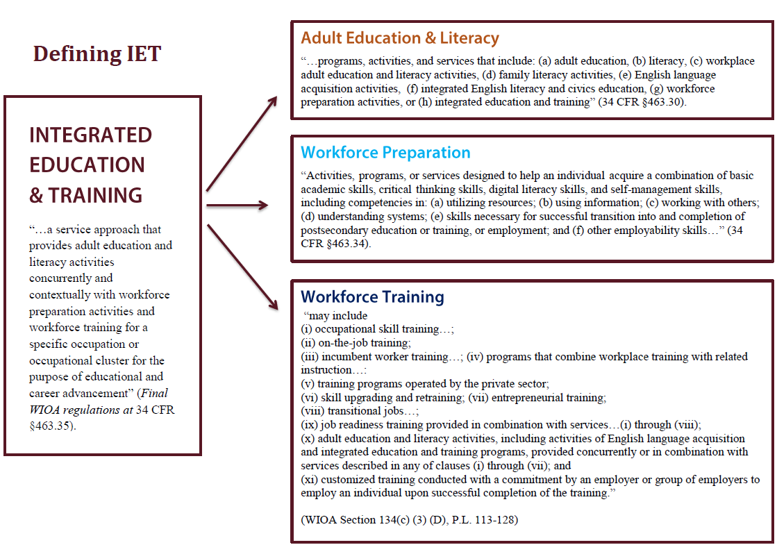

Slide 14
Key Concepts
IELCE funds must be used in combination with IET.
The requirement is on the program and not the individual participants.
There are two options for meeting the requirement.
Students without credential attainment or employment related goals should not be dissuaded from participating in the program.
The new requirements will take time and technical assistance to fully implement.

Slide 15
Assessment Update
GAIN is not submitting to NRS.
Publishers are submitting by Oct 3rd
OCTAE has not committed to how long the process with take
CASAS has not finalized a name for the series
Notes:
A possible suggestion for Federal Registry is Feb. TABE is called 11 and 12. Everything may change from hours in between instruction to scale scores. Best Plus is another assessment so we may review all approved NRS assessments.

Slide 16
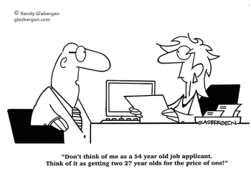
ESL and Workforce Activities
Now that you are in expert in IELCE:
What workforce activities would you like your ESL students do?

Slide 17
Contact Info
frazierb3@michigan.gov
517-241-3256

